Slide 1

WHATSAPP CHAT SENTIMENT ANALYZER
TEAM
ARSHIYA (2203A51002)
SAI ADHITHI NAMA (2203A51027)
SUMAYYA TASNEEM (2203A51031)
B SUMASREE (2203A51039)
R AMULYA (2203A51059)
UNDER THE GUDIENCE- S NURESH KUMAR

Slide 2
PROJECT ABSTRACT
Core Functionality: Automatically analyzes exported WhatsApp chats to determine the emotional tone (sentiment) of messages.
Sentiment Categorization: Classifies messages into Positive, Negative, and Neutral categories.
Key Insight: Provides per-sender statistics, sentiment distribution, and trend over time for deeper user understanding.

Slide 3

PROBLEM STATEMENT
While existing WhatsApp chat analysers effectively quantify communication metrics, they cannot assess the sentimental content of conversations. This limitation hinders a comprehensive understanding of user interactions, as the sentimental context is crucial for interpreting the nuances of communication.

Slide 4

SOLUTION OVERVIEW: THE INSIGHT ENGINE
A system for analyzing exported WhatsApp chat text.
Key Components:
Natural Language Processing (NLP): For statistical analysis and text preparation.
Deep Learning (LSTM): To capture sequential and temporal behavioural patterns.
FOX Optimization: For improved hyperparameter tuning and model performance.
Interface: An interactive, user-friendly web interface built with Streamlit.

Slide 5
METHODOLOGY: THE DATA PIPELINE
Step 1: Data Acquisition — Exporting raw .txt chat files.
Step 2: Preprocessing & Cleaning
Parsing timestamps and user identifiers.
Handling emojis, media, and special characters.
Tokenization, Stopword Removal, and Normalization.
Step 3: Feature Engineering — Preparing the clean text for the Deep Learning model.
Step 4: Statistical Analysis — Generating initial metrics and visualizations.

Slide 6
DEEP DIVE: LSTM - THE POWER OF CONTEXTUAL MEMORY
Why LSTM?
Standard Neural Networks struggle with sequential data, such as chat messages.
Long Short-Term Memory (LSTM):
A special type of Recurrent Neural Network (RNN) designed to remember information for long periods, which is crucial for understanding the context and flow of a conversation.
Key Concept: It uses gates (Input, Forget, Output) to control the flow of information.
Application: Ideal for detecting nuanced sentiment and predicting future message patterns.

Slide 7
OPTIMIZATION SECRET: THE FOX ALGORITHM
The Need for Optimization: Deep Learning models have many parameters (hyperparameters) that need precise tuning for optimal performance. Manual tuning is inefficient.
FOX (Fennec Fox Optimization): A nature-inspired meta-heuristic algorithm used to efficiently tune the LSTM's hyperparameters.
Impact: The FOX-Optimized model demonstrates:
Improved Accuracy
Reduced Training Time

Slide 8
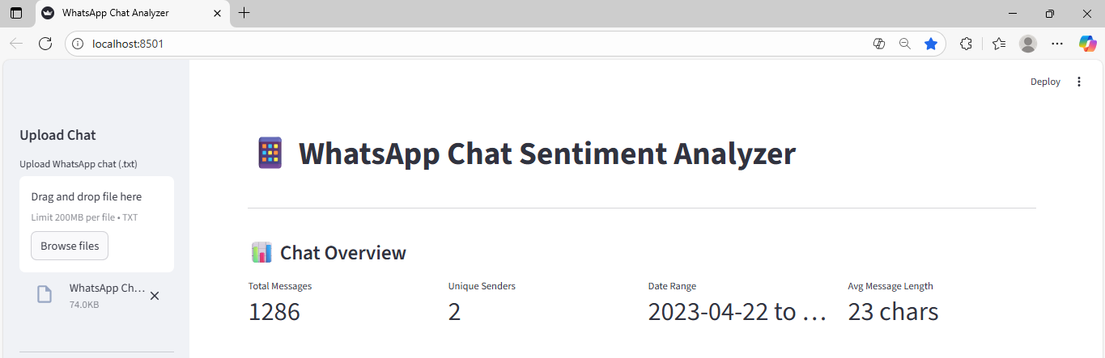
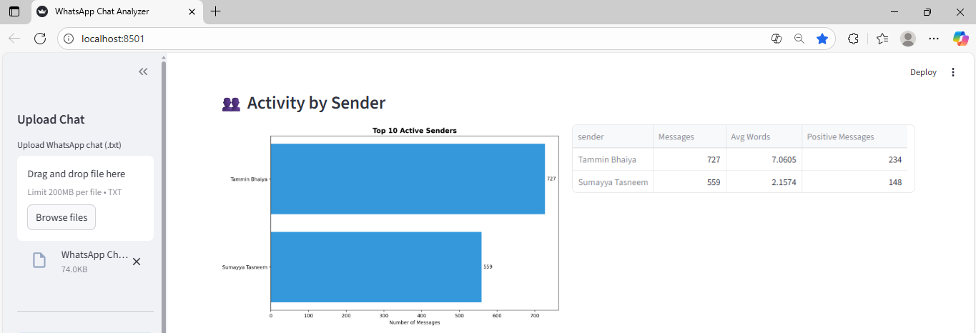
RESULTS I: COMMUNICATION BEHAVIORAL INSIGHTS
User Activity Distribution: Identifying the most talkative participants.
Statistical Analysis:
Total messages, Total media, and links shared.
Most Active Sender and Peak Day/Time of conversation.

Slide 9
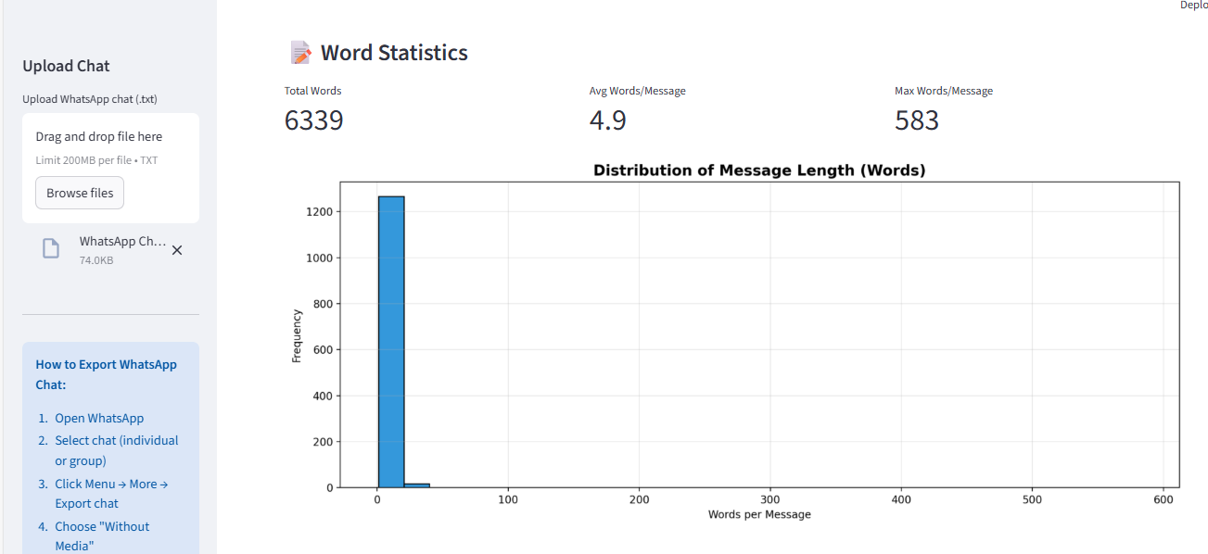
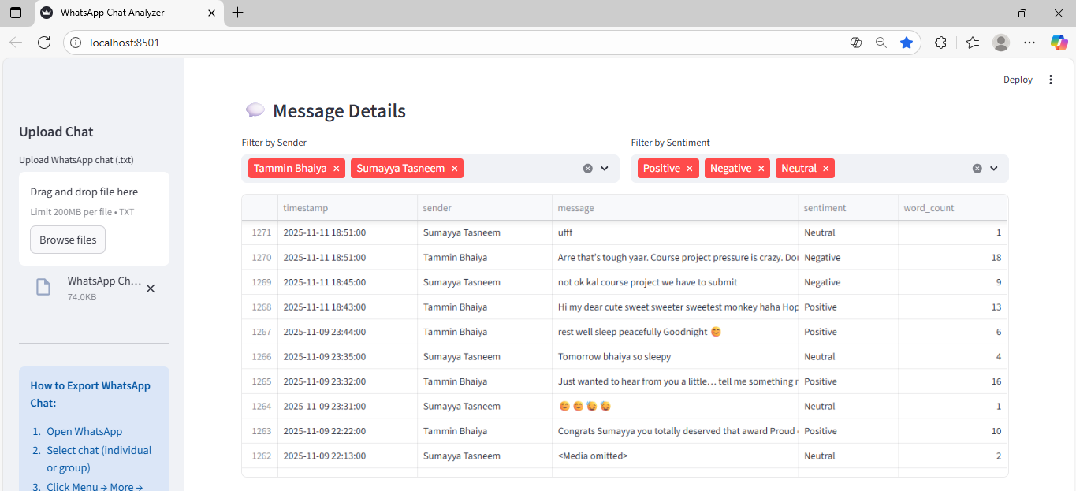
Key Visualizations: Bar charts of message counts per user. Weekly Activity Heatmaps (time of day vs. day of week). Word Clouds and Emoji Usage analysis. Summary Generation: Providing concise summaries of long chat threads.

Slide 10
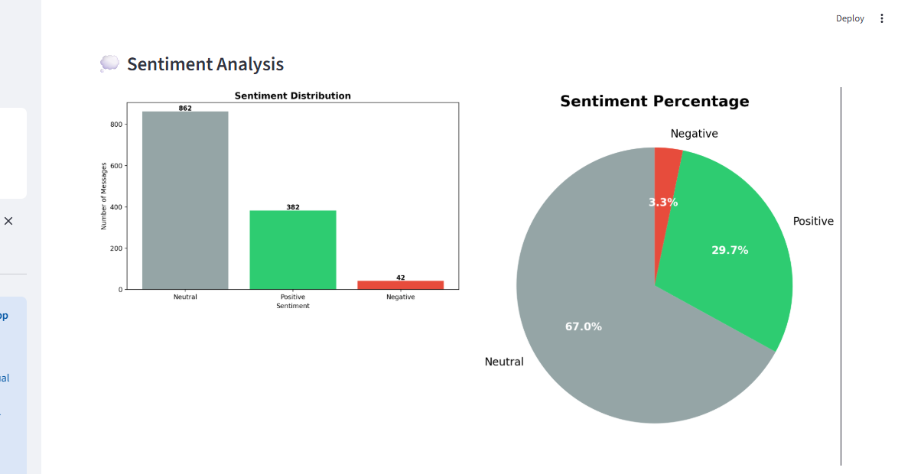
RESULTS II: SENTIMENT & PREDICTIVE TRENDS
Sentiment Analysis:
Gauging the overall emotional tone (Positive, Negative, Neutral) of the conversation or individual users.
Sentiment analysis line graphs over time.
Predictive Modeling:
The LSTM model is trained to predict future message patterns. Showing LSTM prediction charts.

Slide 11
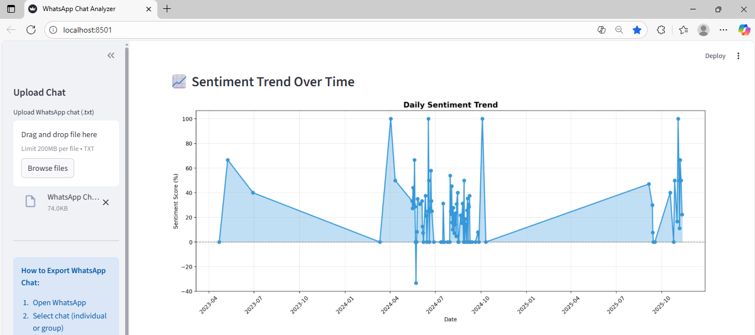

Slide 12
MODEL PERFORMANCE: THE PROOF IS IN THE METRICS
EVALUATION METRICS:
Mean Squared Error (MSE)
Root Mean Squared Error (RMSE)
Mean Absolute Error (MAE)
THE ADVANTAGE OF FOX:
Compare: Present a table or chart showing the improved metrics and reduced training time of the FOX-Optimized LSTM model against a base LSTM or traditional ML model.

Slide 13

REAL-WORLD IMPACT: DIVERSE APPLICATIONS
Customer Support Analytics: Analyzing customer chats to gauge satisfaction and common pain points.
Relationship and Emotional Pattern Detection: Providing deep behavioral insights into personal communication.
Workplace Monitoring: Understanding team engagement and identifying communication bottlenecks.
Social Media Data Mining: Extending the core technology to other chat platforms.

Slide 14

CONCLUSION
Successful Implementation: The project successfully implements a complete WhatsApp chat analysis system using advanced Deep Learning and Optimization.
Key Takeaway: The system provides powerful behavioral insights, sentiment patterns, and predictive trends with improved efficiency due to FOX Optimization.
Final Call: We have turned unstructured chat data into actionable conversational intelligence.

